Slide 1
Assessment Professional Development Series
Module 4: Quantitative Data (Numbers Beyond Face Value)
Written by Kathryn Kuczaj, Susan Moore and Vicki Highstreet

Slide 2
Module 4: Quantitative Data
Presented by:
Kathryn Kuczaj | Student Involvement
Susan Moore | Dean of Students Office
Vicki Highstreet | Campus Recreation

Slide 3
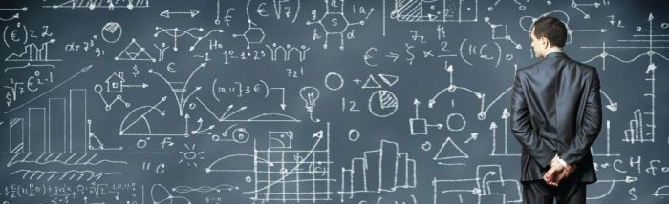
-Why quantitative? -Types of quantitative data, and collection techniques. -What is your data telling you?
Overview of Today’s Module:

Slide 4
Learning Outcomes
Understand the benefits and challenges of collecting and utilizing quantitative data.
Determine the necessary procedures for successful quantitative data collection.
Identify the significance of information, relative to the stakeholders.

Slide 5
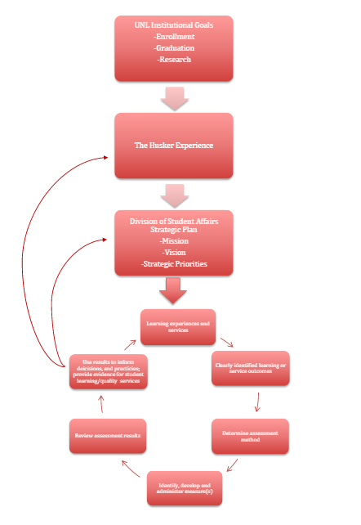
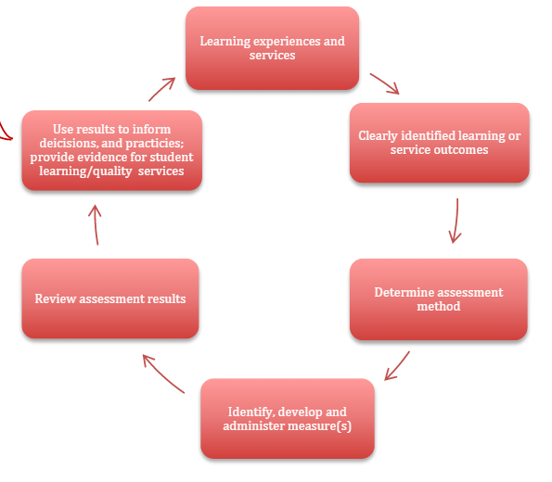
Notes:
Looking at our assessment cycle, today we will be lingering in these 3 steps: determining your assessment method; administering those assessments; and then looking at the results you get.

Slide 6
What Is Quantitative Data Analysis?
“It is a systematic approach to investigations during which numerical data is collected and/or the researcher transforms what is collected or observed into numerical data…”
…in other words:
It often answers the “what” and “how many” questions we have about something, and gives us evidence to either support or contradict an idea or assumption we might have.

Slide 7
Pros & Cons of Quantitative Data
Advantages | Disadvantages
Larger number of subjects or sample sizes | Results are limited to numerical descriptions
Allows for greater objectivity and accuracy | Preset answers may not necessarily reflect a persons experiences or feelings
Allows for easier replications and comparisons | Self perception of something versus actual experience of something can skew data
Personal bias can be avoided | Conscious of how you word questions.

Slide 8
Quantitative Data Collection Techniques
Tracking or Counting
Participant numbers
Social media and web analytics
Experiments
Surveys
Closed-ended survey questions
Scales
Demographics
Cost Analysis
Notes:
Today we will look at 3 main types of quantitative data collection techniques.

Slide 9
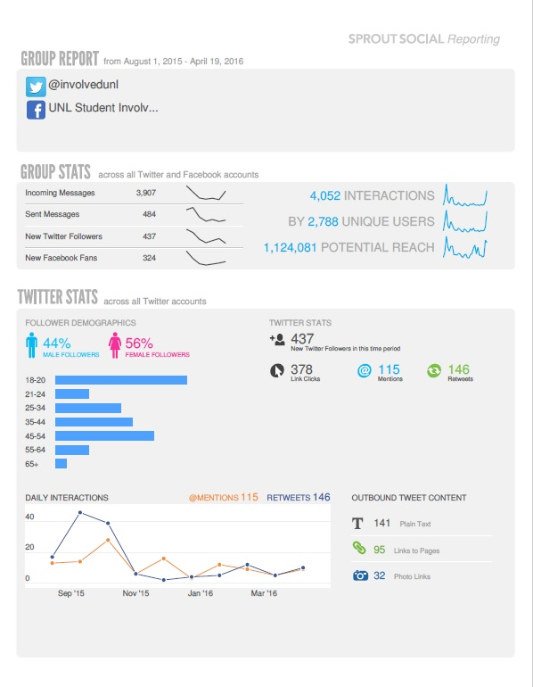
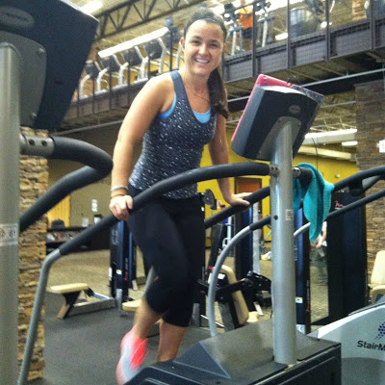
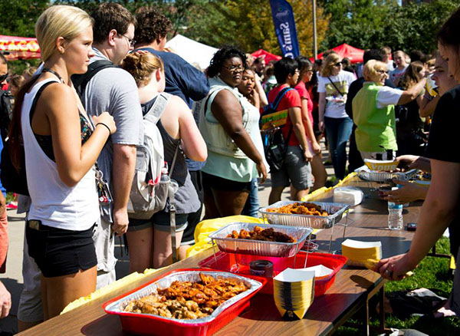
Tracking/Counting
Notes:
Pic 1, 2, 3 – how many people attended an event, have visited an office, asked for a specific resource?
Pic 4 – how many people have visited your website, FB page, or tweeted at you?
Pic 5 – don’t forget about the fun numbers! How many flights of stairs have been climbed on the stair masters?

Slide 10
Surveys
Closed-ended questions
Limit the answers of the respondents to response options provided on the questionnaire.
Four types of measurement can influence the type of questions you ask:
Nominal data
Ordinal data
Interval data
Ratio data

Slide 11
*Nominal Data*
Data has no logical order, is basic classification data Example: demographics (gender, ethnicity, etc.)
Ordinal Data
Data has a logical order, but the distances between the values are not constant Example: student organization officer positions or rubrics (beginner, intermediate, advanced)

Slide 12
*Interval Data*
Data is continuous and has a logical order, it has standardized differences, but no natural zero Example: Likert scale (on a scale of 1-5, how satisfied were you with…)
Ratio Data
Data is continuous and has a logical order, it has standardized differences and has a natural zero Example: height, weight, age, length, etc.

Slide 13
Best Practices for Likert Scales
Best Practices & Tips
Keep it labeled | Since some might not immediately know what end of the spectrum skews positively versus negatively, use words to label your scales.
Keep in unipolar | Try to use a “unipolar” scale that ranges from “extremely” to “not at all,” rather than extremely one thing to extremely another.
Keep it odd | This gives your scale a midpoint. A good rule of thumb is to use 5-point scales when using unipolar scales, and 7-point scales when using bipolar scales.
Keep it continuous | Response options in a scale should be equally spaced from each other.
Keep it inclusive | Scales should span the entire continuum of responses.
Notes:
A Likert scale measures attitudes and behaviors using answer choices that range from one extreme to another. Unlike a simple “yes / no” question, a Likert scale allows you to uncover degrees of opinion.

Slide 14
Cost Analysis
Involves adding up the benefits of a course of action (program, service, event) and then comparing them with the costs associated with it.
Results are often expressed as a payback period (the time it takes for benefits to repay costs)
Can be used in a wide variety of situations:
Deciding whether to hire new team members.
Evaluating a new program or event.
Determining the feasibility of a large purchase.
Notes:
Example: Get Rec’d is an event that is costly both in time of staff and money for Campus Recreation and Community Vendors they bring in. To see if this event is really worth putting on, they would need to see if they are getting the interest from the students following the event. Are more students coming the rec? Are more students visiting the vendors who were in attendance? If the answer is no, it might be worth reevaluating the event. QUESTIONS??

Slide 15
Case Study: Party at the Union
Purpose:
To provide a space where students, primarily first years, can meet other students, learn about a few student clubs and organizations, and have an engaging evening during their first few days on campus.
General outcomes for attendees:
Meet new people
Navigate the NE Union with confidence
Try something new to them
Engage in diverse interactions
Learn about RSOs on campus
Other things to the host department would like to know:
What motivated students to go?
How long did they stay at the event?
Were they satisfied with the NE Union facilities?

Slide 16
In your groups… Using techniques we have discussed so far (or maybe some we haven’t) think about how you might quantitatively assess the following:
Group 1 | Group 2 | Group 3
How long did students stay at the event? | What motivated students to attend the event? | Did the students meet new people?
Did students learn about the Recognized Student Organizations at the event? | Did students engage in a diverse interaction? | Did the students try something new?
Did students feel comfortable navigating the Nebraska Union? | Were the students satisfied with the Nebraska Union facilities? | Which activities at the event were worth the cost?
Notes:
Be creative! Think of specific questions if you are going the survey route. What might be some ways you could assess “in the moment”?

Slide 17
Is the data reliable and representative?
Getting the right sample size.
First you must determine how accurate you want your data to be.
Confidence intervals (margin of error) – the positive and negative deviation you allow on your survey results.
Confidence level – how often the percentage of the population lies within the boundaries of the confidence intervals.
So if 90% of your survey respondents (random sample of the event attendees) were satisfied with the Nebraska Union facilities, a confidence interval of 5% would mean that you can be “sure” that 85%-95% of the overall participants (all event attendees) were satisfied.
Notes:
How do you know which to use? Best practice for programmers and event evaluators is 95% Confidence Level, with a 5% Confidence Interval.

Slide 18
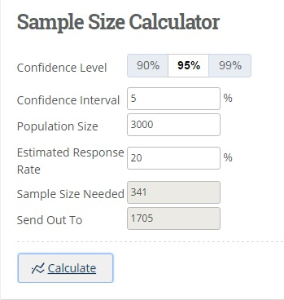
Is the data reliable and representative?
Getting the right sample size.
Then with the help of technology, you can determine your sample size.
Notes:
There are many sample size calculators out there, this particular one is one of the features through Campus Labs. Example: If my party at the union attendance was 3,000 students, and I want my data to be 95% confident with a 5% confidence interval, I would need responses from a sample of 341 attendees.

Slide 19
But wait!
Getting the right sample size.
Don’t forget about response rates (ratio of people who completed the survey to the total number of surveys sent out)!
20% response rate is considered good for online surveys.
Notes:
Example: Since I have estimated a response rate of only 20%, and I still want to try and hit my sample size target of 341, it would be best to send out the survey to about 1700 students who attended the event. QUESTIONS??

Slide 20
What is your data telling you?
Now that we have determined our questions and conducted our assessments, we can look at our results and begin to interpret.
Descriptives
Cross Tabbing & Correlations
Percentage Differences & Percentage Increases

Slide 21
Descriptives
A descriptive refers to calculations that are used to describe the data set. The most common descriptives are:
Mean – the numerical average of scores for a variable.
Median – the numerical middle point or score.
Mode – the most common number score or value for a variable.

Slide 22
Descriptives
Notes:
For example: We are using a Likert scale for this particular question, where Strongly agree =5 and Strongly disagree = 1. Another great feature of Campus Labs, is that you can run additional statistical analysis for each question, and it will populate these numbers for you!

Slide 23
Cross Tabbing
A cross tab shows the relationship between two or more survey questions, and provides you with a side-by-side comparison of how different groups of respondents answered your survey questions.
Notes:
For example: If we wanted to look at the amount of time spent at Party at the Union based on gender, we could cross tab our question related to time spent at the event with the demographics data related to gender.

Slide 24
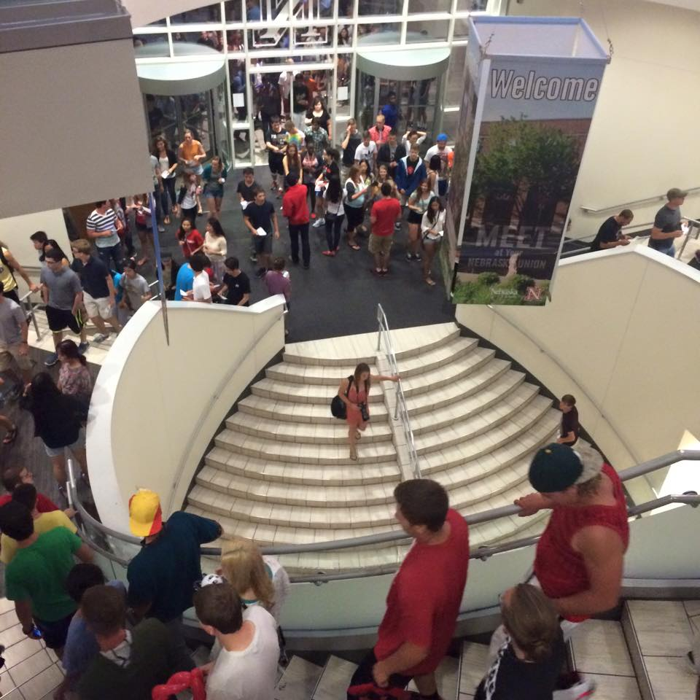
Correlations
A correlation is a statistical calculation which describes the nature of the relationship between two variables.
However, correlation does NOT explain causation.
Notes:
For example, we might see a strong correlation between attendees who agreed that attending Party at the Union eased their transition into college, and their cumulative gpa that following semester, however this does not mean party at the union is the reason the students grades are higher.

Slide 25
Percent Difference vs. Percent Change
200%
40%
Notes:
First, understanding the difference between the two is very important. Let’s say that a small auto dealership sells on average 2 cars per day. One day the dealership sells 6 cars. This is an increase of 4 cars, or 200%. The larger dealership across the street sells on average 10 cars per day and sold 14 cars that same day. Here the larger dealership had the same increase in cars sold as the small dealership but it only increased its car sales by 40%. So even though the larger dealership sold more in total it didn’t increase its sales by more than the small dealership.

Slide 26
Percent Differences
Percent differences is the basic subtraction of one data point from another.
If in 2014 the number of Party at the Union attendees who agreed that they interacted with someone different from them was 52%, and in 2015 65% of attendees agreed to that same question…
65 - 52 = 13
The percent difference is 13%. Which means, the percentage of Party at the Union attendees who agreed that they interacted with someone different from themselves had increased by 13 percentage points from 2014 to 2015.

Slide 27
Percent Change
Percent change is the change as a percent of the old value.
If in 2014 the number of Party at the Union attendees who agreed that they interacted with someone different from them was 52%, and in 2015 65% of attendees agreed to that same question…
It would be easy to misconstrue this information by saying that there is a 13% increase in students agreeing to have interacted with someone different from them at Party at the Union.

Slide 28
Percent Change
If in 2014 the number of Party at the Union attendees who agreed that they interacted with someone different from them was 52%, and in 2015 65% of attendees agreed to that same question…
Instead, to find the true percent change, we simply take the amount of change (percent difference) and divide it by the initial value. Then multiply by 100.
13 / 52 = 0.25
0.25 x 100 = 25%
So, we can say that there was a 25% increase in the number of attendees who agreed to interacting with someone different from them.

Slide 29
Be careful which one you use!
200%
40%
Notes:
Both methods to evaluate changes in data over time are very helpful. But you have to be careful which one that you use, and how you are sharing the data. As seen in the car example you can easily overstate what happened within the certain time period. If you said that we sold 4 more cars than usual today, for an increase of 40%, which was a good day. But if you were the other dealership and sold 4 more than usual and increased sales for that day by 200%, this was a great day. QUESTIONS??

Slide 30
What if your data disproves your assumptions?
Notes:
It’s ok! This is one of the main reasons we assess things. So that we can determine if what we are doing is working and producing the outcomes we want. If they are not, then we have evidence to make sound decisions for change. We should not shy away from our WHOLE data story, even the not so great results.

Slide 31
Campus Resources
Campus Labs – Baseline
Tutorials, webinars, helpful consultants
Statistics Tutors
Not just for students anymore
PEARL Guidebook
Campus resource for assessment methods, reporting, and other higher ed best practices.
Campus Colleagues who collect data. #freethedata
What data is already out there and available to us?
Your Student Affairs Assessment Committee Members

