Slide 1
Student Affairs Professional Development Series
Module 5: Qualitative Basics
Written by Colette M. Polite, PhD

Slide 2
Module 5: Qualitative Basics
Presented by:
Colette M. Polite, Ph.D.| TRIO Programs

Slide 3
Learning Outcomes
You will gain a better understanding of qualitative methods in general and in relation to student affairs assessment.
Identify the potential ways qualitative methods can be useful to your departments.
Simulate and implement an effective qualitative method strategy for use in program evaluation (i.e. Case Study handout).

Slide 4
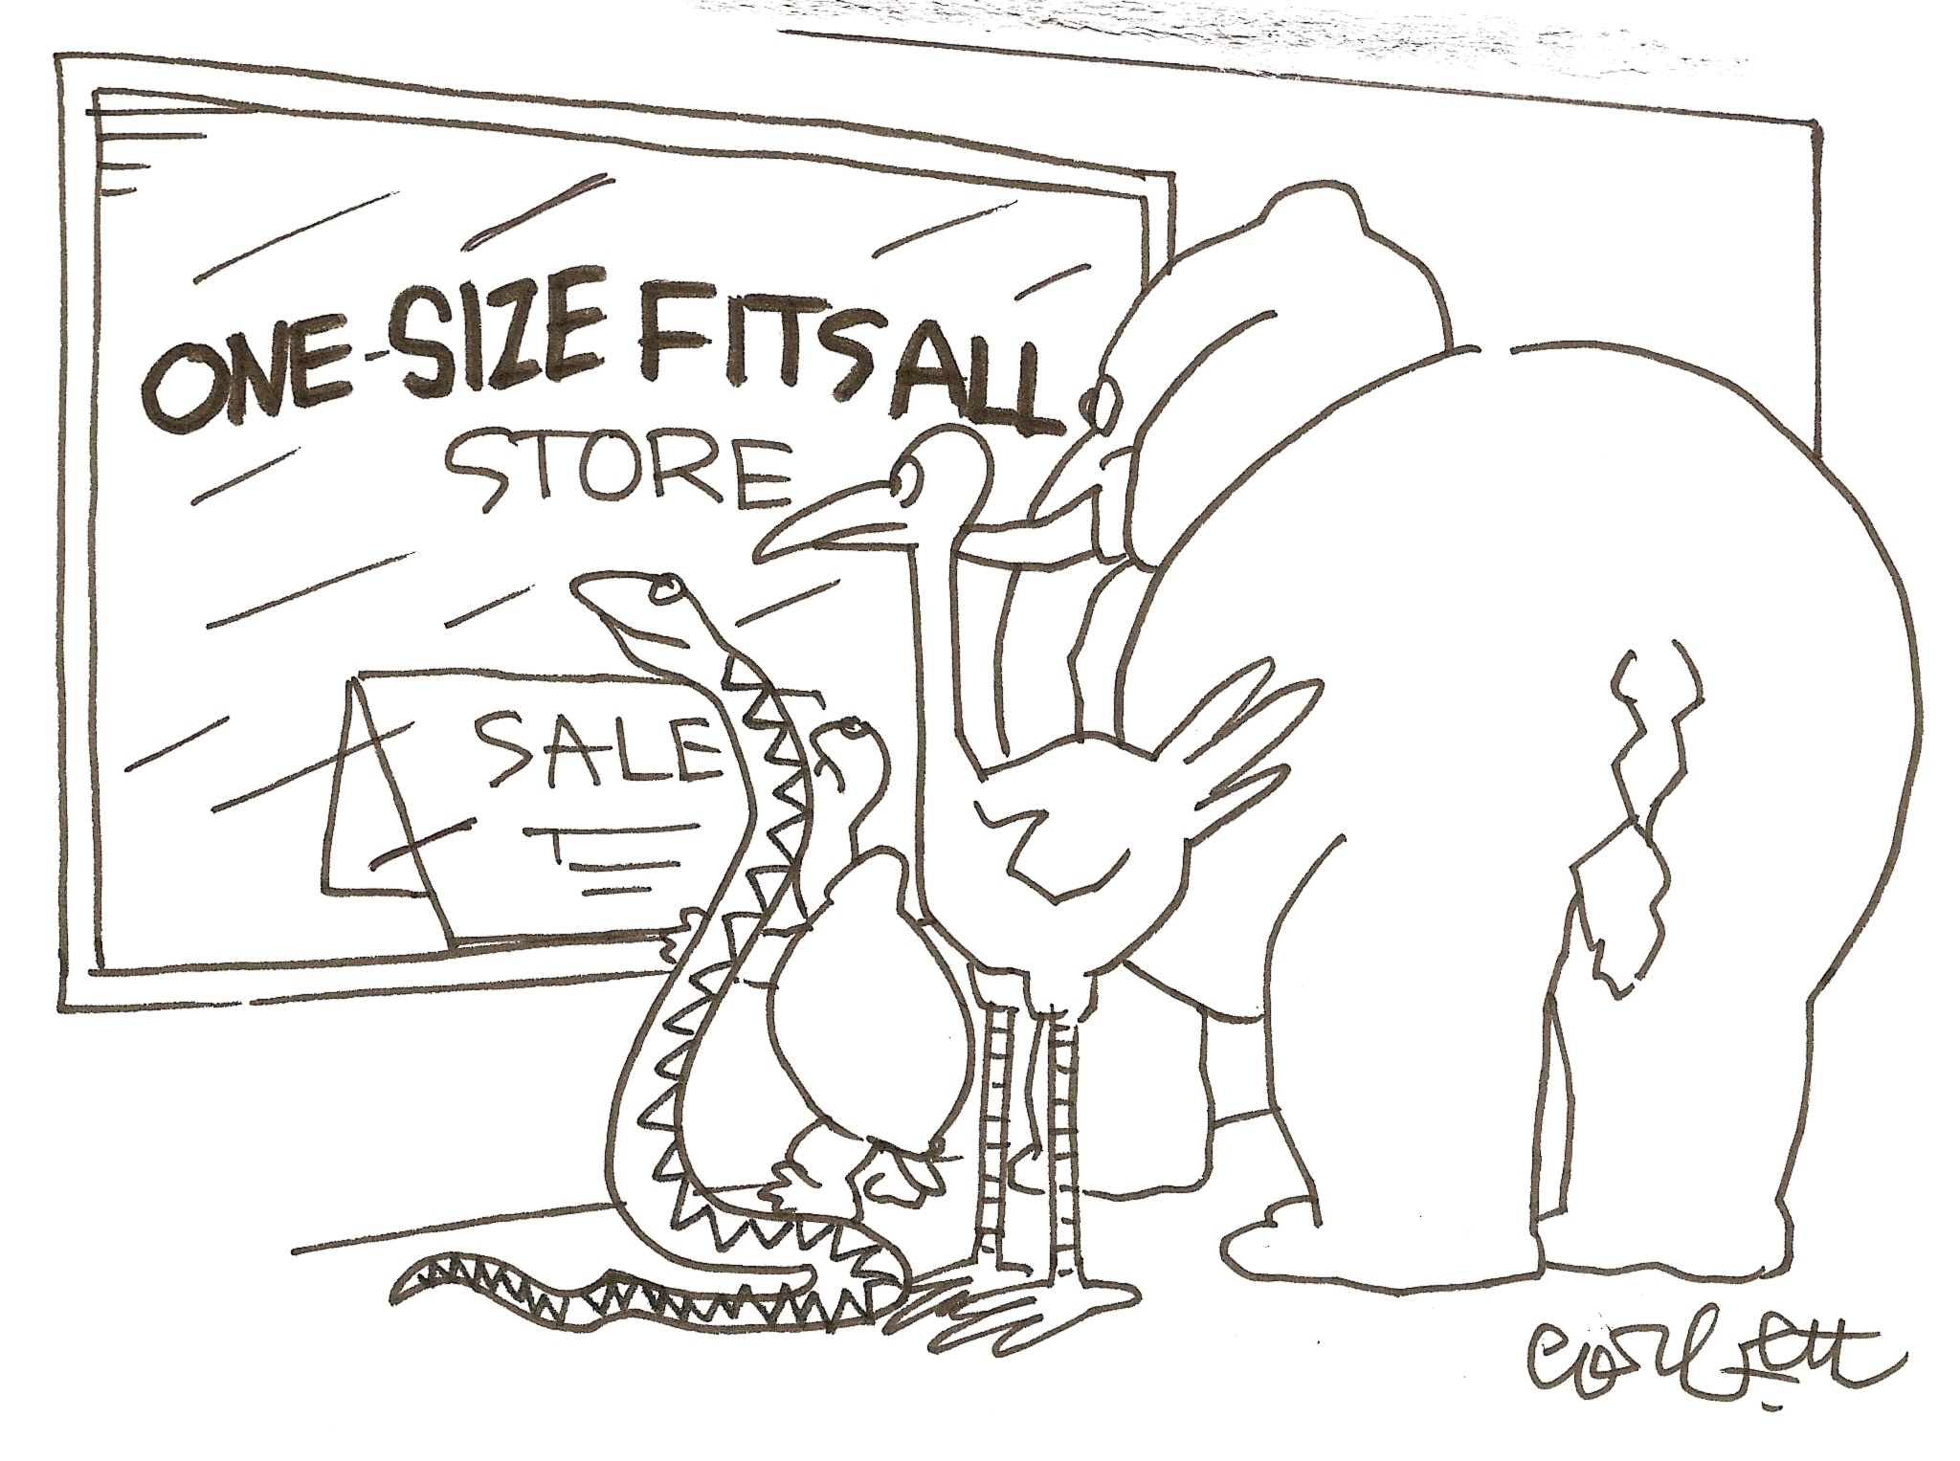
Overview & Basics
Qualitative methods: why they prove to be useful

Slide 6
Qualitative Methods defined as:
"Qualitative research is multimethod in focus, involving an interpretive, naturalist approach to its subject matter.” ~ Norman K. Denzin (1994)
“Qualitative research is an inquiry process of understanding based on distinct methodological traditions of inquiry that explore a social or human problem. The research builds a complex, holistic pictures, analyzes words, reports detailed views of informants, and conducted the study in natural setting.” ~ John Creswell (1998)

Slide 7
QUAN-QUAL WARS (since 1980’s)
By the mid 1980’s, qualitative methods were more widely used and becoming more prevalent among researchers.
Since the late 1980’s, there have been at least three paradigm “wars”:
Postpositivistic war again positivism
Wars between postpositivistic, constructivist & critical theory paradigms
Evidence-based methodologists & mixed-methods, interpretive & critical theory schools (current war being waged)

Slide 8
The “Why” Behind Qualitative Methods
Assumptions | Characteristics & Implications
Ontological | Worldviews- provide different perspectives & “realities”
Epistemological | Knowing- the classic “field” study, getting close to culture being studied.
Axiological | Values (bias)- the researcher makes his/her “presence” known in the study. Direct insertion.
Rhetorical | Personal/Literary- the researcher uses First Person and tells a Story (e.g. Narrative, Case Study).
Methodological | Process-based- uses inductive logic to arrive at an emerging design.

Slide 9
Paradigms & Worldviews of Q.R.
Worldview | Description
POSTPOSITIVISM | Research projects designed with logically related steps. There are multiple perspectives not just a single reality. (use of MAXQDA)
CONSTRUCTIVISM | Relies heavily on the viewpoints of participants. Typically, the use of broad, open-ended questions to capture experiences of participants.
ADVOCACY/PARTICIPATORY | This approach seeks to yield or effect social change (institutional, systemic, lives). The “voice” of the participants is paramount and central to this design.
PRAGMATISM | Does not rely on any one or particular philosophical or reality. Focus on the “what” and “how” of research. There are always social, cultural, political contexts.

Slide 10
Interpretive Communities
Postmodern
Perspectives
Feminist
Theories
Critical Theory & Critical Race Theory
Advocacy, Action, Marginalized Groups & Anti-Oppression
Disability Theories
Queer Theory

Slide 11
What are Qualitative Methods: Five Traditional Approaches
Approaches
Narrative Research | Draws up on the stories, lived experiences of participants. It is considered both the Method & the Phenomenon.
Phenomenological Research | This study focuses on the meaning for participants in their lived experiences. For example, what do the individuals in common?
Grounded Theory Research | Research aims to move past description and “discover” or arrive at a theory or analysis. This general overview includes the input & is generated by the participants.
Ethnographic Research | The Researcher depicts, describes & interprets the shared experiences, language, interactions, beliefs of a small cultural group. (e.g. culture-sharing among ǃKung/!Xun).
Case Study | Project Investigator studies a bounded system (single) or a multiple bounded system (multi) over time with in-depth methods.

Slide 12
Qualitative Methods At-a-Glance
Ethnographic research
Creative groups
Conflict groups
Peer Groups
In-depth interviews
Focus groups
Diaries analyzing
Qualitative Methods

Slide 13
Formative & Summative
BRIEFLY
Formative | Summative
Portfolios: participants engage with professionals/practitioners through the assessment process. | A Final Portfolio/Project: shows the progression of participant in course/program.
Written Summary: Occur immediately after a presentation, lesson, program | Benchmark Assessment: Administered at the end of a course, program to perhaps determine certification.
Examples: Needs Assessment, Evaluability Assessment, Implicit Assessment & Process Assessment | Examples: Outcome Evaluation, Impact Evaluation, Cost-benefit Analysis, Meta-Analysis

Slide 15
The How with QUAL
Location site/Individual
Gaining Access & Making Rapport
Collecting Data
Recording Information
Resolving Field Issues
Purposely Sampling
Storing Data
Classic Data Collection Cycle
– Creswell

Slide 16
QUAL Data Collection
Access & Rapport: consider the Institutional Review Board and ethical concerns. Permission must be granted from participants.
Purposeful Sampling: The Research Inquirer selects and identifies participants purposefully to inform the & grasp understanding of the research problem. (Events, Actors, Artifacts, Settings) However, a degree of flexibility must be afforded.
Attention to Detail, provide rich description & explanation. Specific is not “bad” in this sense, it is necessary as this research is about not generalizing.
Techniques: Access to location, Interviews, Observations, Documents, Photos

Slide 17
QUAL Data Analysis
There are three widely accepted strategies and one must bear in mind that each “approach to inquiry” has its own additional requirements for analysis.
PREPARE & ORGANIZE DATA (transcripts, photos) FOR ANALYSIS
REDUCE DATA INTO THEMES VIA CODING
REPRESENT DATA IN FIGURES, TABLES, DISCUSSION

Slide 18
CASE STUDY
See handout
Party at the Union Case Study
Party at the Union is an event hosted on the Saturday evening of the first week of Big Red Welcome. The purpose of the event is to provide a space where students, primarily first years, can meet other students, learn about a few of the student clubs and organizations on campus, and have an engaging evening during their first weekend on campus. There are various hands-on activities, performances, and games that occur throughout the evening, and it is topped off with a dance party and midnight pancake feed on the Union Plaza. There are a multitude of departments and recognized student organizations that assist in making this event a success, and it has become a staple in the line-up of Big Red Welcome programs…

Slide 19
CASE STUDY Methodology
YIN (2003a, p.2) "the distinctive need for case studies arises out of the desire to understand complex social phenomena" because "the case study method allows investigators to retain the holistic and meaningful characteristics of real-life events," such as organizational and managerial processes, for example.

Slide 20
CASE STUDY – when to use it
Three situations determines its use:
Research Question -it requires a more descriptive question or an explanatory question.
The study of a phenomenon in its own environment and “Real-World” context (i.e. you need to go beyond interviews) to arrive at a deeper understanding.
It is used as an EVALUATIVE tool.

Slide 21
CASE STUDY DESIGN
Steps | Explanations
1. Define the Case | The case is the main unit of analysis. Yet, the boundaries between the case and its context can be blurred. The case should be unique, siginificant & special. Set very high standards for this design.
2. Four Types | First, is the CASE single or multiple? Next, determine whether it is holistic or embedded. *see handout
3. Using Theory in Design | Theoretical perspectives provide an overview or “starting point” for analysis. However, theories can be added and its possible to abandon them after initial data collection.

Slide 22
Sources of Data
Direct Observations- conventional method (5 senses) & formal instrument (tabulate, record interactions between staff & student).
Interviews- open-ended questions, non-structured interviews, aim to gain an understanding for participants construct her/his reality.
Archival Records- electronic records, libraries, public records. Note: archival data can be both quantitative & qualitative.
Documents- letters, journals, newspapers.
Participant-observation- researcher will select the real-life scene and solicit participant input.
Physical artifacts- authentic work or first-hand download of information.

Slide 23
Briefly: VALIDITY & EVIDENCE
TRIANGULATING IN CASE STUDY:
Establishing, converging lines of evidence- which will make your findings as robust as possible.
Most desirable: three of more sources all point to the same set of interpretations, events, circumstances, or viewpoints.
Be cautious about “echoing.”

Slide 24
CASE STUDY ANALYTIC TECHNIQUES
Pattern matching (explanatory / descriptive)
Explanation-building (mainly explanatory)
Time-series analysis
*All major evidence was reviewed and interpretations were covered.

Slide 25
RETURN TO Case Study
Brief Discussion
Please email me with additional questions:
colette.polite@unl.edu

Slide 26
Resources:
CAMPUS LABS:
http://baselinesupport.campuslabs.com/hc/en-us/articles/204304565-Qualitative-Data-Analysis-video-
CASE STUDY:
http://www.qualitative-research.net/index.php/fqs/article/view/75/153January%202006#g31

Slide 27
Open-ended QUESTIONS
Responses will not be limited
The question doesn’t restrict responses
There is a future opportunity for Focus Groups, Interviews
Definite Qualitative Project will be planned

Slide 28
A big THANK YOU to the co-contributors:
Veva Cheney, Director of Services for Students with Disabilities
Linda Schwartzkopf, Director of the Office of Fraternity & Sorority Life

